Slide 1

SQL Training
April 2022

Slide 2
SQL

Slide 3
What is SQL?
SQL stands for Structured Query Language
SQL lets you access and manipulate databases held in a RDBMS
RDBMS stands for Relational Database Management System
The data in RDBMS is stored in database objects called tables. A table is a collection of related data entries, and it consists of columns and rows
There are different versions of SQL language e.g., MySQL, PostgreSQL, Microsoft SQL
The scope of SQL includes
data query (what will be covered in this session)
data manipulation (insert, update and delete)
data definition (schema creation and modification)
data access control

Slide 4
Example Queries

Slide 5
Sample Table
Table name: customer
Column names (important ones only):
gender
dayofbirth
monthofbirth
yearofbirth
customerid
creationdate

Slide 6
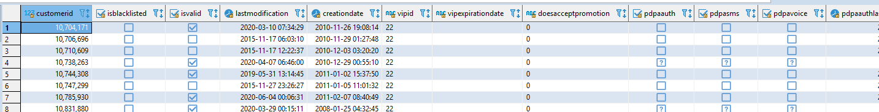
Queries – SELECT and LIMIT
Query:
select *
from customer
* = all columns
Query:
select *
from customer
limit 2

Slide 7
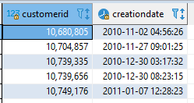
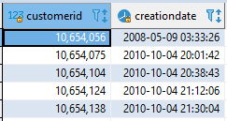
Queries – choosing columns and ordering
Query:
select customerid, creationdate
from customer
limit 5
Query:
select customerid, creationdate
from customer
order by customerid
limit 5

Slide 8
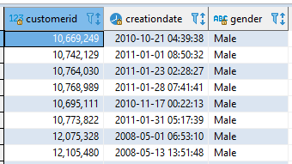
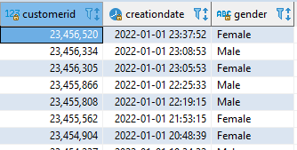
Queries – filtering and comparison operator
Query:
select customerid, creationdate, gender
from customer
where gender='Male'
Query:
select customerid, creationdate, gender
from customer
where creationdate>='2022-01-01'

Slide 9


Queries – aggregate functions, GROUP BY, and renaming columns
Query:
select count(customerid)
from customer
Available aggregate functions:
count
avg
max
min
sum
Query:
select gender, count(customerid) as total_by_gender
from customer
group by gender

Slide 10
Sample Table 2
Table name: basket
Column names (important ones only):
recordid
customerid
productsales
ordertime

Slide 11
Queries – JOIN
customer table
basket table
customerid | gender
1 | Male
2 | Female
3 | Male
recordid | customerid
X1 | 1
X2 | 1
X3 | 2
X4 | 3
X5 | 3
We can use JOIN to connect the two tables – notice that both tables have the ‘customerid’ column and we can use that as the related column
Question:
Who orders more, male or female customers?

Slide 12

Queries – JOIN and aliases (nicknaming tables for easy reference)
Query:
select c.gender, count(distinct b.recordid) as number_of_orders
from customer c
join basket b on c.customerid=b.customerid
group by c.gender
order by number_of_orders desc
Types of JOIN:
Inner join: JOIN
Left join: LEFT OUTER JOIN
Right join: RIGHT OUTER JOIN
Full join: FULL OUTER JOIN
This query answers the question:
Who orders more, male or female customers?

Slide 13
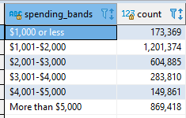
Queries – CASE … WHEN, nested queries, and referring to columns by its position (1, 2, 3, etc.)
Query:
select
case when spent>5000 then 'More than $5,000'
when spent>4000 then '$4,001-$5,000'
when spent>3000 then '$3,001-$4,000'
when spent>2000 then '$2,001-$3,000'
when spent>1000 then '$1,001-$2,000'
else '$1,000 or less' end as spending_bands, count(customerid)
from
(
select customerid, sum(productsales) as spent
from basket
group by 1
) spending_table
group by 1
order by 1
For group by and order by, we can instead use numbers to refer to columns based on its position in the table
In the example shown, we use group by 1 to tell SQL to group by the first column in the resulting table, that is customerid in the nested table and spending_bands in the final table
Same goes for order by 1 which means we want to get the final table sorted by the first column in the resulting table, that is spending_bands
This query answers the question:
How many customers spent 0-1000, 1000-2000, 2000-3000, 3000-4000, 4000-5000, and 5000+?

Slide 14
Case Study – McDonald’s

Slide 15
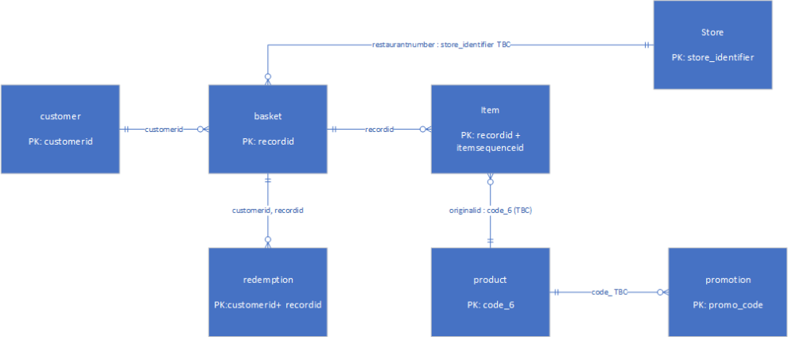
Tables provided by McDonald’s for McDelivery
List of Tables provided by McDonald’s, and common variables connecting the tables
Customer Records (contains customerid)
Basket Records (contains customerid, recordid. couponcode, restaurantnumber)
Item Records (contains recordid, productid)
Product Records (contains productid)
Store Records (contains restaurantnumber)
Promotion Records (contains couponcode)
Campaign Redemptions (contains recordid, couponcode)

Slide 16
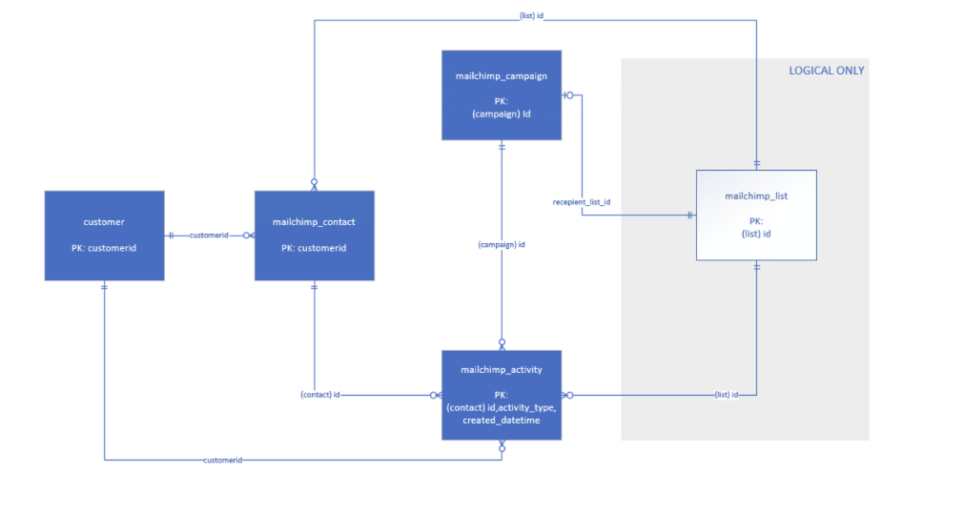
Tables available on Mailchimp
List of Tables on Mailchimp, and common variables connecting the tables
Mailchimp Campaign (contains campaignid)
Mailchimp Activity (contains customerid, campaignid)
Mailchimp Contact (contains customerid)

Slide 17
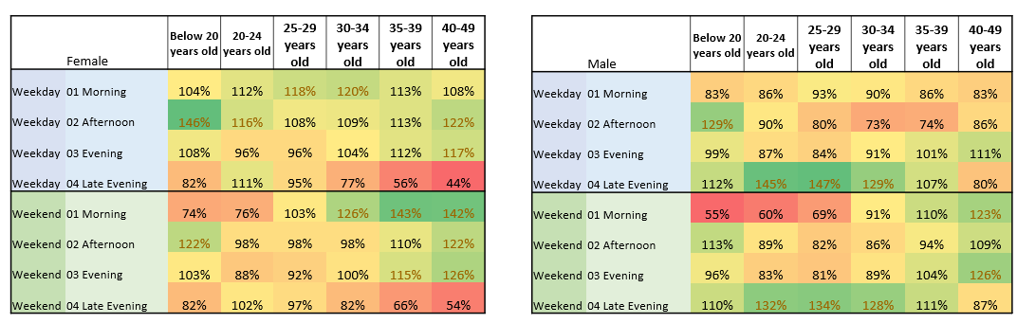
How we used SQL
Exploratory Data Analysis
Summarizing the data’s main characteristics,
whether any demographic variables form any identifiable clusters/personas, and
whether any behavioral/purchase variables are more prevalent in specific demographic groups

Slide 18
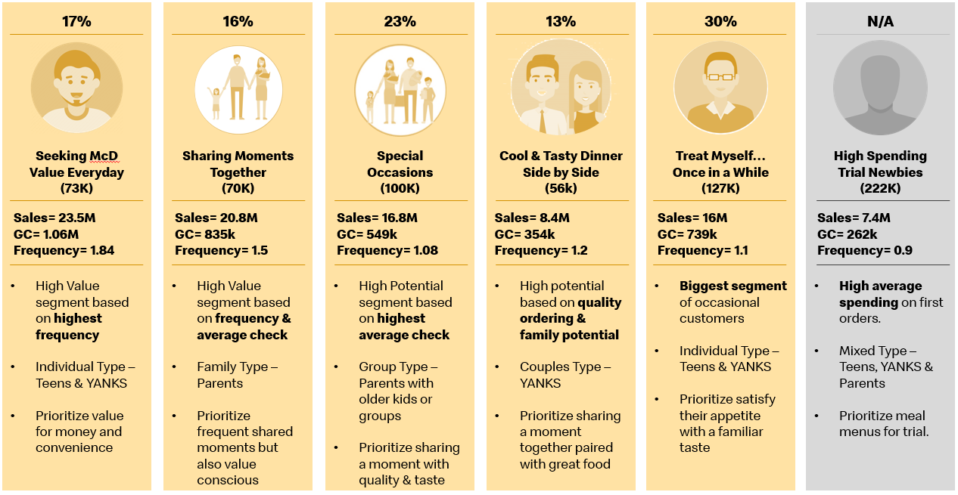
How we used SQL
2. Clustering (also with K-Means clustering)
SQL is not used to cluster, but rather to prepare the data for further clustering purposes

Slide 19
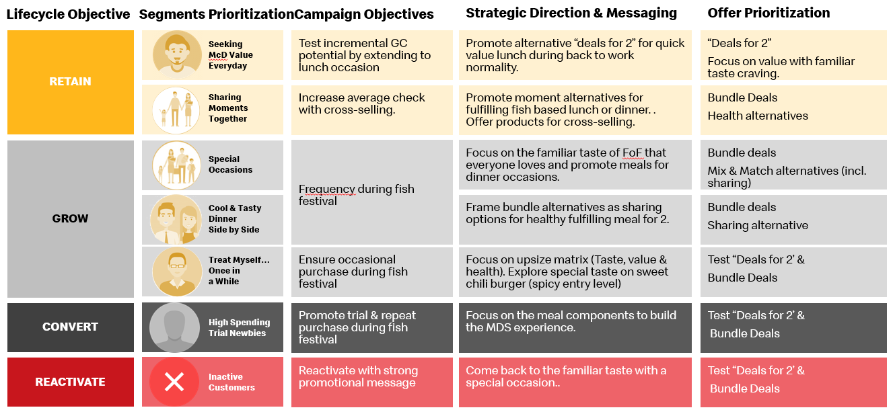
How we used SQL
3. Labeling customers based on pre-defined clusters
On top of the K-Means clusters we identified other specific segments too such as INACTIVE
SQL (using CASE…WHEN) is used to label the customers based on their purchase and demographic variables

Slide 20
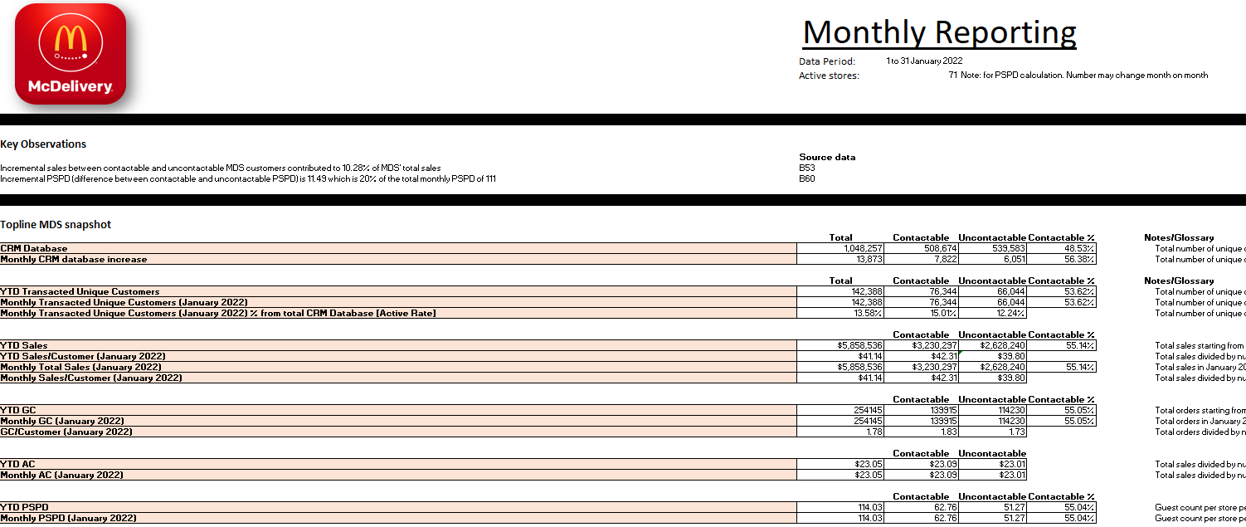
How we used SQL
4. Reporting
Every month, we use SQL to churn out reporting tables numbers on CRM sales, order volume, and CRM email activity numbers

